Slide 1


Machine learning Master Class
DAy - 2/5
House price prediction

Slide 2
01
02
03
Sale Prediction
House price prediction
Income Spent Clustering
04
05
Web Ad Optimization
Movie Recommendation System

Slide 3

Stay Till End to Get Materials

Slide 4
House price Prediction
01
Linear Regression

Slide 5



30 Day Video Lectures (Value: ₹4,000) 28+ Projects (Value: ₹5,000) Warriors Way Community (Value: ₹2,000) Weekly Master Mind (Value: ₹1,000) Bonus Task, Assignment (Value ₹1,000) Technical Materials (PPT & Mindmap) (Value: ₹2,000) Internship E-Certificate
Total Value
₹15000
OFFER
₹999
Paid Internship on Machine Learning

Slide 6

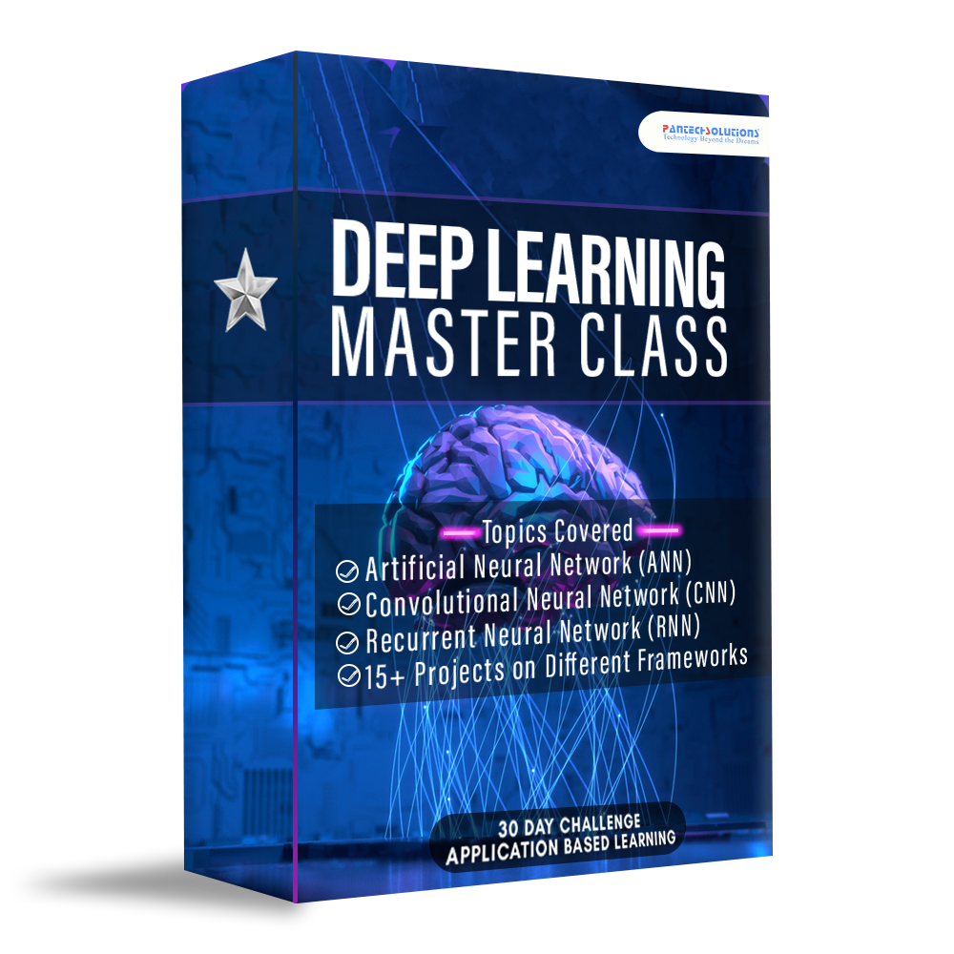
Access to 90 Days Video Lectures (Value ₹12,000) 70+ Projects - From Scratch (Value ₹15,000) Technical Materials (PPT & Mindmap) (Value ₹6,000) Saturday Zoom Live Q&A Session + New Lectures on the current trend (Value ₹10,000) Lifetime Private community (Value ₹2,000) 3 Internship E-Certificate(A.I & M.L & D.A) (6 Month Validity)
Total Value
₹35000
OFFER
₹999
Launch OFFER – 3 Courses (Python + M.L + D.L)

Slide 7
Our Most sold Bundle
ALL COURSES WITH 2 YEARS OF VALIDITY WITH
JOB ASSISTANCE

Slide 8
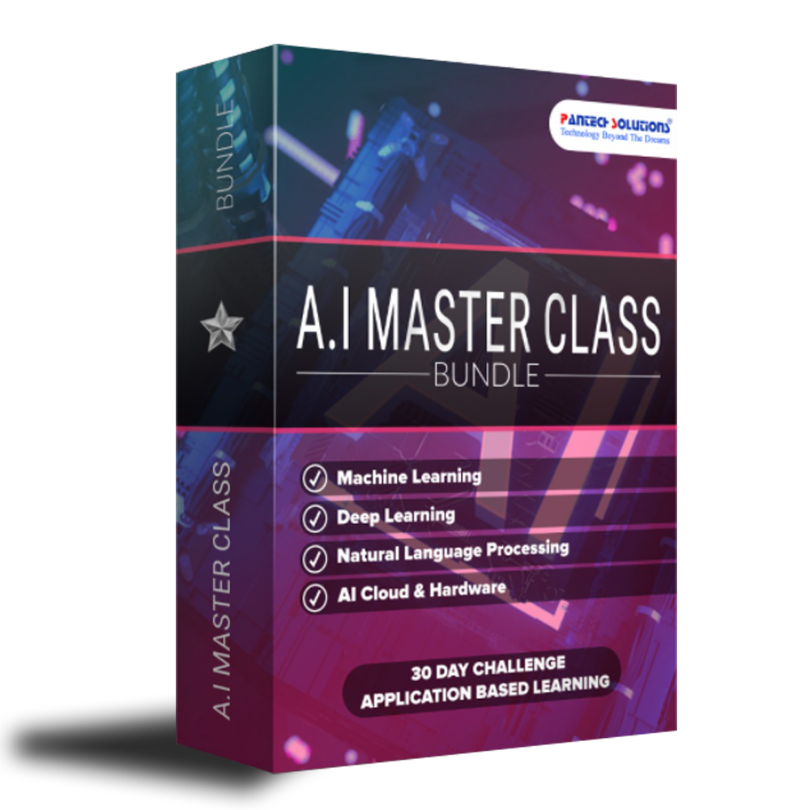
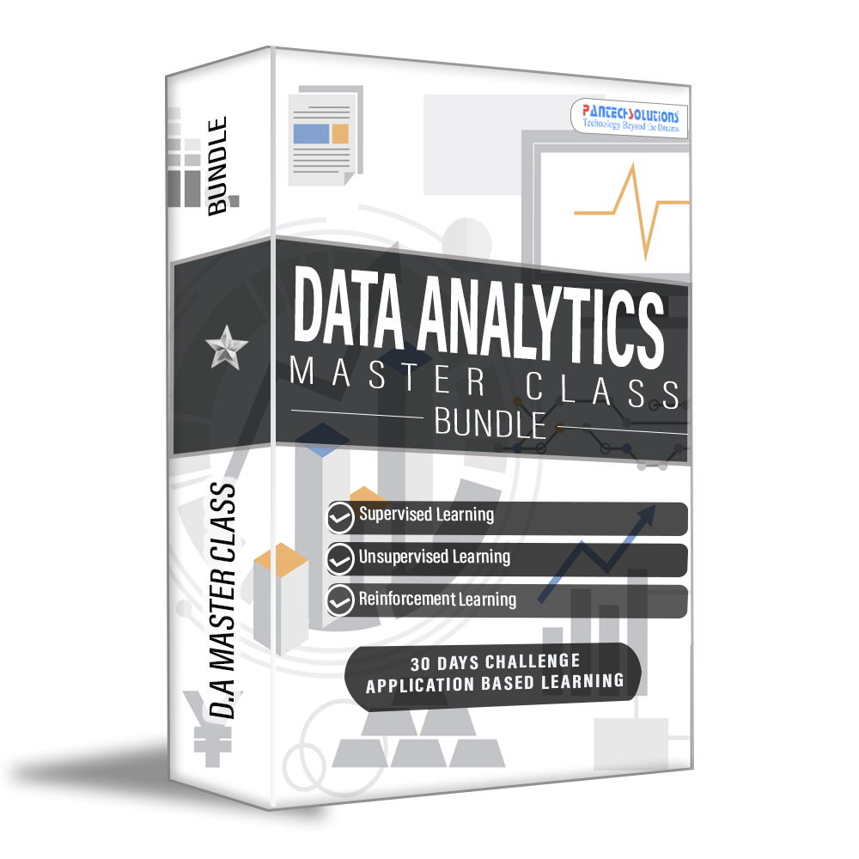


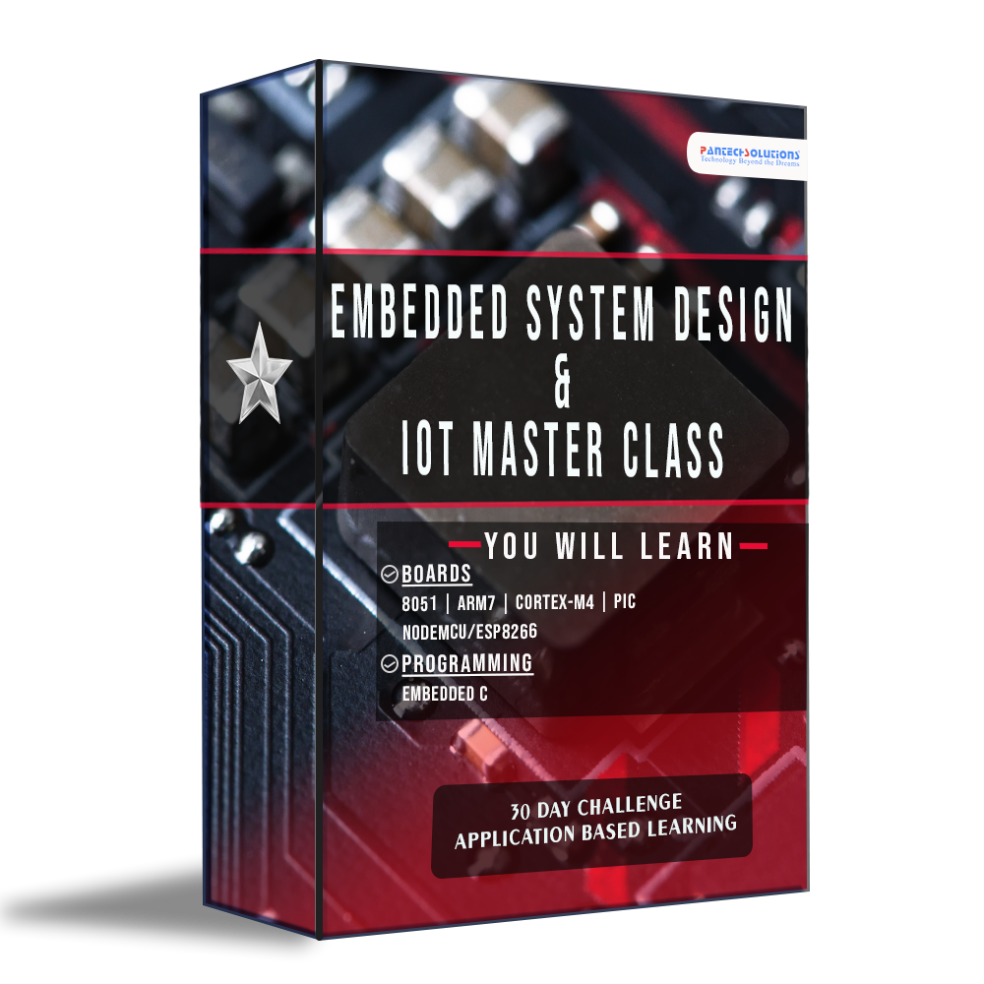




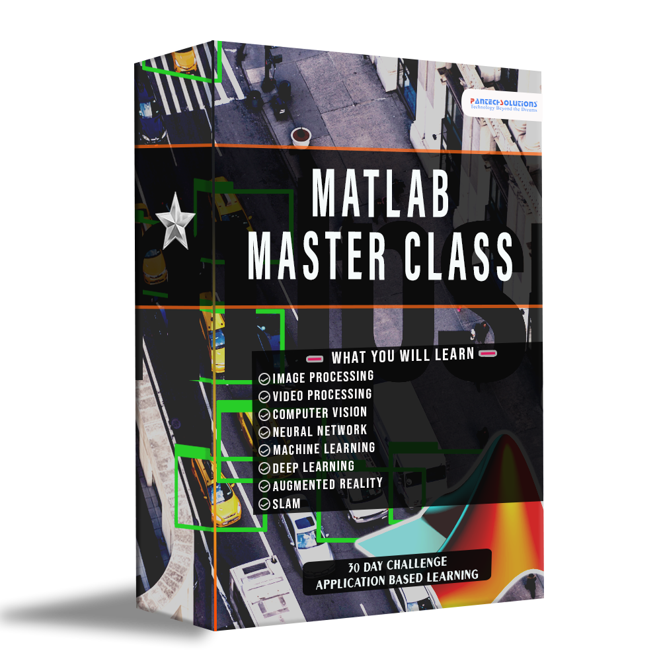







Slide 9
19 Courses JOB Assistance 300 + Projects Intensive Hackathon Live session From Scratch Live session on every Saturday Interview Questions JOB Posting 19 Internship Certificate 2 year validity Soft Skill Courses
Total Value
₹115000
OFFER
₹7,999
FESTIVE OFFER – Data Science + Embedded system Job Assistance Program - ( Warriors Way Gold Membership )

Slide 10
Q & A Session
Post your questions in G-Form, Questions will be answered in upcoming Master Mind

Slide 11

MANY THANKS!
Be part of our FREE Community?
Connect with me through LinkedIn
+91 7305845758
www.pantechsolutions.net

